Slide 1
Sine and cosine ratios
Trigonometry

Slide 2
How our teaching resources are designed for the classroom

Slide 3
I can derive the sine and cosine ratios from the sides of a right-angled triangle.

Slide 4
The hypotenuse is the side of a right-angled triangle which is opposite the right angle.
The adjacent side of a right-angled triangle is the side which is next to both the right angle and the marked angle.
The opposite side of a right-angled triangle is the side which is opposite the marked angle.
The trigonometric ratios are ratios between each pair of lengths in a right-angled triangle.

Slide 5

Sine and cosine ratios
Ratio tables with the unit circle
The opposite and the hypotenuse
The adjacent and the hypotenuse
Using a calculator without a unit circle

Slide 6
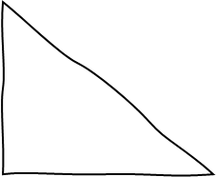
Ratio tables with the unit circle
If you need to find a length of a side of a triangle with a hypotenuse that isn’t 1…
Then you can sketch a similar triangle with a hypotenuse of 1.
sketch a similar triangle
4 cm
1 cm
sin(30°)
30°
30°
a cm
cos(30°)

Slide 7
Ratio tables with the unit circle
angle | sine | cosine | tangent
0 | 0 | 1 | 0
5 | 0.087 | 0.996 | 0.087
10 | 0.174 | 0.985 | 0.176
15 | 0.259 | 0.966 | 0.268
20 | 0.342 | 0.94 | 0.364
25 | 0.423 | 0.906 | 0.466
30 | 0.5 | 0.866 | 0.577
35 | 0.574 | 0.819 | 0.7
40 | 0.643 | 0.766 | 0.839
45 | 0.707 | 0.707 | 1
50 | 0.766 | 0.643 | 1.192
55 | 0.819 | 0.574 | 1.428
60 | 0.866 | 0.5 | 1.732
65 | 0.906 | 0.423 | 2.145
70 | 0.94 | 0.342 | 2.747
75 | 0.966 | 0.259 | 3.732
80 | 0.985 | 0.174 | 5.671
85 | 0.996 | 0.087 | 11.43
90 | 1 | 0 | ∞
cosine
Use the table of trig values to find the length of the corresponding side of your sketched triangle.
We want to find the length of the side adjacent to the 30° and the right angle.
30
0.866
4 cm
1 cm
sin(30°)
30°
30°
cos(30°)
a cm
0.866

Slide 8
Ratio tables with the unit circle
We can now use proportional reasoning to find the length of the adjacent side of our original triangle.
hypotenuse | adjacent
1 | 0.866
4 | a
× 4
0.866 × 4
3.464
4 cm
1 cm
sin(30°)
30°
30°
3.464
0.866
a cm
× 4

Slide 9
Ratio tables with the unit circle
angle | sine | cosine | tangent
0 | 0 | 1 | 0
5 | 0.087 | 0.996 | 0.087
10 | 0.174 | 0.985 | 0.176
15 | 0.259 | 0.966 | 0.268
20 | 0.342 | 0.94 | 0.364
25 | 0.423 | 0.906 | 0.466
30 | 0.5 | 0.866 | 0.577
35 | 0.574 | 0.819 | 0.7
40 | 0.643 | 0.766 | 0.839
45 | 0.707 | 0.707 | 1
50 | 0.766 | 0.643 | 1.192
55 | 0.819 | 0.574 | 1.428
60 | 0.866 | 0.5 | 1.732
65 | 0.906 | 0.423 | 2.145
70 | 0.94 | 0.342 | 2.747
75 | 0.966 | 0.259 | 3.732
80 | 0.985 | 0.174 | 5.671
85 | 0.996 | 0.087 | 11.43
90 | 1 | 0 | ∞
sine
5.6 cm
Using this table of trig values, find the length of the side labelled x cm on the sketched triangle.
20°
20
0.342
p cm
5.6 cm
20°
1 cm
20°
sin(20°)
p cm
0.342 cm
x cm

Slide 10
Ratio tables with the unit circle
angle | sine | cosine | tangent
0 | 0 | 1 | 0
5 | 0.087 | 0.996 | 0.087
10 | 0.174 | 0.985 | 0.176
15 | 0.259 | 0.966 | 0.268
20 | 0.342 | 0.94 | 0.364
25 | 0.423 | 0.906 | 0.466
30 | 0.5 | 0.866 | 0.577
35 | 0.574 | 0.819 | 0.7
40 | 0.643 | 0.766 | 0.839
45 | 0.707 | 0.707 | 1
50 | 0.766 | 0.643 | 1.192
55 | 0.819 | 0.574 | 1.428
60 | 0.866 | 0.5 | 1.732
65 | 0.906 | 0.423 | 2.145
70 | 0.94 | 0.342 | 2.747
75 | 0.966 | 0.259 | 3.732
80 | 0.985 | 0.174 | 5.671
85 | 0.996 | 0.087 | 11.43
90 | 1 | 0 | ∞
1) Fill in the blanks and ratio table. By considering corresponding sides, find the length of side labelled a cm.
sketch a similar triangle
12 cm
1 cm
sin(15°)
15°
15°
a cm
cos(15°)
hypotenuse
1
12

Slide 11
Ratio tables with the unit circle
2) Fill in all the blanks and ratio tables to find the values of b and c by considering corresponding sides.
c cm
1 cm
70°
18 cm
7.5 cm
55°
b
cm
70°
55°
hypotenuse
1
7.5
hypotenuse
1
18

Slide 12
Ratio tables with the unit circle
angle | sine | cosine | tangent
0 | 0 | 1 | 0
5 | 0.087 | 0.996 | 0.087
10 | 0.174 | 0.985 | 0.176
15 | 0.259 | 0.966 | 0.268
20 | 0.342 | 0.94 | 0.364
25 | 0.423 | 0.906 | 0.466
30 | 0.5 | 0.866 | 0.577
35 | 0.574 | 0.819 | 0.7
40 | 0.643 | 0.766 | 0.839
45 | 0.707 | 0.707 | 1
50 | 0.766 | 0.643 | 1.192
55 | 0.819 | 0.574 | 1.428
60 | 0.866 | 0.5 | 1.732
65 | 0.906 | 0.423 | 2.145
70 | 0.94 | 0.342 | 2.747
75 | 0.966 | 0.259 | 3.732
80 | 0.985 | 0.174 | 5.671
85 | 0.996 | 0.087 | 11.43
90 | 1 | 0 | ∞
1) Fill in the blanks and ratio table. By considering corresponding sides, find the length of side labelled a cm.
sketch a similar triangle
12 cm
1 cm
sin(15°)
15°
15°
0.259
cm
a cm
cos(15°)
0.966 cm
hypotenuse | adjacent
1 | 0.966
12 | 11.592 cm
× 12

Slide 13
Ratio tables with the unit circle
2) Fill in all the blanks and the ratio tables to find the values of b and c.
c cm
sin(55°)
0.819 cm
1 cm
70°
cos(70°)
0.342 cm
18 cm
7.5 cm
55°
b
cm
cos(55°)
0.574 cm
70°
55°
1 cm
hypotenuse | opposite
1 | 0.819
7.5 | 6.1425
hypotenuse | adjacent
1 | 0.342
18 | 6.156
× 7.5
× 18

Slide 14
Sine and cosine ratios
Ratio tables with the unit circle
The opposite and the hypotenuse
The adjacent and the hypotenuse
Using a calculator without a unit circle

Slide 15
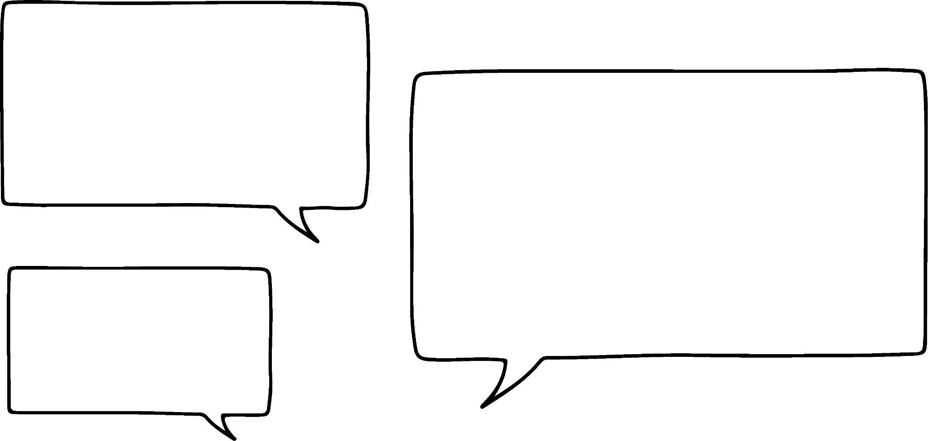
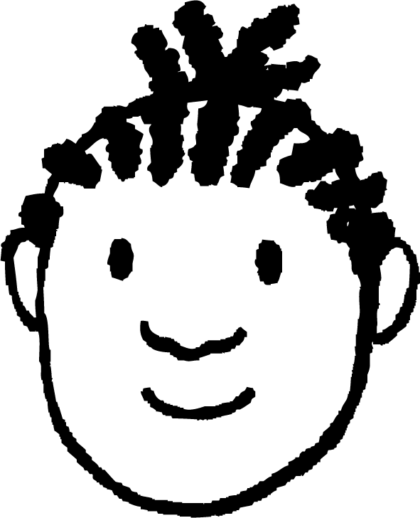
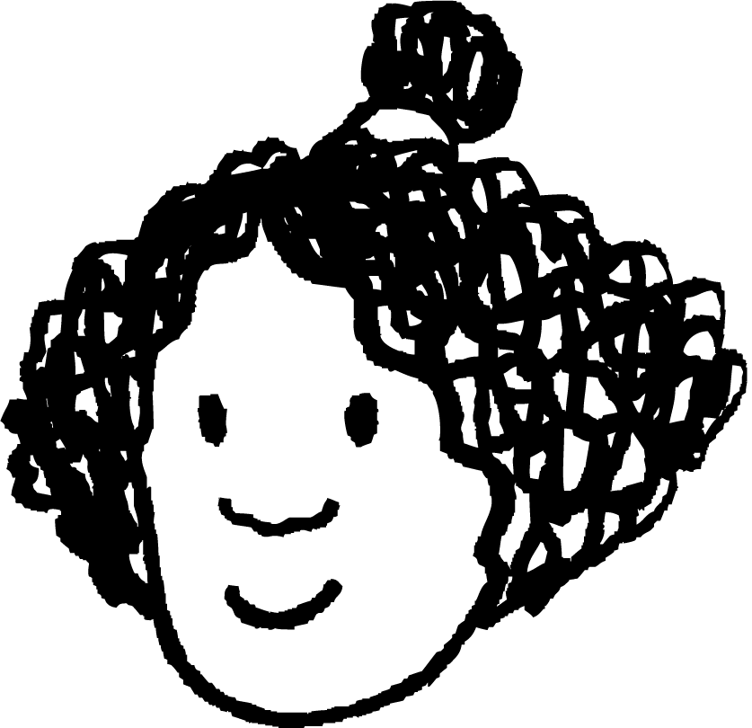
The opposite and the hypotenuse
Doesn’t that mean all the other sides are also multiplied by the same scale factor?
Then the scale factor between them is always the hypotenuse of the other triangle!
I think I’ve spotted a pattern!
I have two similar triangles.
One of them is from the unit circle and has a hypotenuse of 1.
Jacob
× 7.3
Izzy
1 cm
7.3 cm
4.1902 cm
7.3 × 0.574 cm
7.3 × sin(35°) cm
y cm
sin(35°)
35°
35°

Slide 16
The opposite and the hypotenuse
The pattern Izzy noticed works for all right-angled triangles that are similar to one from the unit circle.
This triangle can have a hypotenuse of any length (let’s label it h),
and an angle of θ°,
then the side opposite the angle θ° will be h × sin(θ°).
× h
1 cm
h cm
h × sin(θ°) cm
y cm
sin(θ°)
θ°
θ°

Slide 17
The opposite and the hypotenuse
The side opposite an angle (of size θ°) in a right-angled triangle is always sin(θ°) multiplied by the length of the hypotenuse.
You can also get to the same result by considering the multiplicative relationship between the hypotenuse and opposite sides.
opposite side = h × sin(θ°)
h cm
h × sin(θ°) cm
y cm
× sin(θ°)
Izzy
θ°

Slide 18

The opposite and the hypotenuse
By using this relationship, find the values that should go in these gaps.
opposite side = h × sin(θ°)
opposite side = × sin( )
46
75
a
b
46 cm
opposite side
Hence, find the length of the side opposite the angle 75°.
44.43 cm
75°

Slide 19
The opposite and the hypotenuse
…but, is it possible to find the length of the hypotenuse if we know an angle and the length of the side opposite it?
So, we can find the length of any “opposite” side if we know the angle it is opposite and the length of the hypotenuse…
Jacob
7.3 cm
h cm
y cm
10 cm
35°
35°

Slide 20
The opposite and the hypotenuse
It is possible to find the length of a hypotenuse if we know:
another angle on the right-angled triangle
the length of the side opposite this angle
We can do this by substituting known values in the triangle, and rearranging the equation we end up with.
opposite side = h × sin(θ°)
10
= h × sin(35°)
h cm
17.42 cm
10
= h × 0.574
10 cm
0.574
0.574
10
= h
= 17.42
35°
0.574

Slide 21
The opposite and the hypotenuse
By using this relationship, find the values that should go in these gaps.
opposite side = h × sin(θ°)
= h × sin( )
46
75
a
b
What value goes into these gaps?
46 = h × sin( 75 )
h cm
46 cm
0.966
0.966
c
d
We can use the table of values to see that sin( 75 ) has a value of 0.966
75°

Slide 22
The opposite and the hypotenuse
1) Find the length of the side opposite the labelled angle using this relationship.
opposite side = h × sin(θ°)
a)
h × sin( θ° ) cm
b)
h × sin( θ° ) cm
77 cm
17.2 cm
h × sin( θ° ) cm
h × sin( θ° ) cm
35°
40°
c)
13.8 cm
d)
55°
0.122 cm
h × sin(θ°)
d cm
20°

Slide 23
The opposite and the hypotenuse
2) Find the length of the hypotenuse when given the side opposite the labelled angle.
opposite side = h × sin(θ°)
a)
b)
h = opposite side
h =
19 cm
0.174
9 cm
80°
10°
3.35 cm
c)
d) A right-angled triangle has an angle of 85°.
The length of the side opposite this angle is 142 cm.
65°
h cm
43 cm
92 cm

Slide 24
The opposite and the hypotenuse
1) Find the length of the side opposite the labelled angle using this relationship.
opposite side = h × sin(θ°)
a)
h × sin( θ° ) cm
b)
h × sin( θ° ) cm
77 cm
17.2 cm
77
40
h × sin( θ° ) cm
17.2
35
h × sin( θ° ) cm
77
0.643
= 9.8728 cm
35°
= 49.511 cm
40°
c)
13.8 cm
d)
55°
0.122 cm
h × sin(θ°)
d cm
= 11.3022 cm
= 0.041724 cm
20°

Slide 25
The opposite and the hypotenuse
2) Find the length of the hypotenuse when given the side opposite the labelled angle.
opposite side = h × sin(θ°)
a)
b)
19
h =
9
h =
19 cm
0.985
0.174
9 cm
= 19.29 cm
= 51.72 cm
80°
10°
3.35 cm
c)
d) A right-angled triangle has an angle of 85°.
The length of the side opposite this angle is 142 cm.
65°
h cm
= 101.55 cm
43 cm
= 142.57 cm
92 cm

Slide 26
Sine and cosine ratios
Ratio tables with the unit circle
The opposite and the hypotenuse
The adjacent and the hypotenuse
Using a calculator without a unit circle

Slide 27
The adjacent and the hypotenuse
The side adjacent to an angle (of size θ°) in a right-angled triangle is always cos(θ°) multiplied by the length of the hypotenuse.
adjacent side = h × cos(θ°)
× h
h cm
1 cm
θ°
θ°
cos(θ°)
h × cos(θ°) cm
adjacent side

Slide 28
The adjacent and the hypotenuse
If we know the hypotenuse and an angle, we can find the length of the side adjacent to that angle and the right-angle.
If we know an angle and the length of the side adjacent to that angle and the right-angle, we can find the length of the hypotenuse.
22 cm
adjacent side
70°
adjacent = h × cos( θ° )
h × cos( θ° )
22 cm
70°
= h × cos( 70° )
22
× cos(70°)
22
22
× 0.342
22
= h × 0.342
The side adjacent to the 70° and the right-angle is 7.524 cm long.
0.342
0.342
= 7.524
22
= h
= 64.33
0.342

Slide 29
The adjacent and the hypotenuse
By using this relationship, find the values that should go in these gaps.
adjacent side = h × cos(θ°)
adjacent side = × cos( )
6
75
a
b
6 cm
75°
adjacent side
Hence, find the length of the side adjacent to the angle 75° and the right-angle.
1.554 cm

Slide 30
The adjacent and the hypotenuse
1) Find the length of the side adjacent to the labelled angle using this relationship.
adjacent side = h × cos(θ°)
a)
b)
17.2 cm
h × cos( θ° ) cm
40°
h × cos( θ° ) cm
77 cm
35°
h × sin( θ° ) cm
h × cos( θ° ) cm
c)
13.8cm
d)
0.122 cm
55°
h × cos(θ°)
20°
d cm

Slide 31
The adjacent and the hypotenuse
2) Find the length of the hypotenuse when given the side adjacent to the labelled angle.
adjacent side = h × cos(θ°)
a)
= h × cos( )
b)
= h × cos( )
19 cm
= h ×
10°
80°
18 cm
3.35 cm
c)
d) A right-angled triangle has an angle of 35°.
The length of the side that is adjacent to this angle and the right-angle is 142 cm.
65°
h cm
43 cm

Slide 32
The adjacent and the hypotenuse
1) Find the length of the side adjacent to the labelled angle using this relationship.
adjacent side = h × cos(θ°)
a)
b)
17.2 cm
h × cos( θ° ) cm
40°
h × cos( θ° ) cm
77 cm
77
40
35°
h × sin( θ° ) cm
77
0.766
h × cos( θ° ) cm
17.2
35°
= 58.982 cm
= 14.0868 cm
c)
13.8cm
d)
0.122 cm
55°
= 0.11468 cm
h × cos(θ°)
20°
= 7.9212 cm
d cm

Slide 33
The adjacent and the hypotenuse
2) Find the length of the hypotenuse when given the side adjacent to the labelled angle.
adjacent side = h × cos(θ°)
b)
a)
= h × cos( )
= h × cos( )
18
10
3.35
80
19 cm
= h ×
0.985
18
h = 19.25 cm
10°
h = 18.27 cm
80°
18 cm
3.35 cm
c)
d) A right-angled triangle has an angle of 35°.
The length of the side that is adjacent to this angle and the right-angle is 142 cm.
65°
h cm
h = 173.38 cm
43 cm
h = 101.65 cm

Slide 34
Sine and cosine ratios
Ratio tables with the unit circle
The opposite and the hypotenuse
The adjacent and the hypotenuse
Using a calculator without a unit circle

Slide 35
Using a calculator without a unit circle
angle | sine | cosine | tangent
0 | 0 | 1 | 0
5 | 0.087 | 0.996 | 0.087
10 | 0.174 | 0.985 | 0.176
15 | 0.259 | 0.966 | 0.268
20 | 0.342 | 0.94 | 0.364
25 | 0.423 | 0.906 | 0.466
30 | 0.5 | 0.866 | 0.577
35 | 0.574 | 0.819 | 0.7
40 | 0.643 | 0.766 | 0.839
45 | 0.707 | 0.707 | 1
50 | 0.766 | 0.643 | 1.192
55 | 0.819 | 0.574 | 1.428
60 | 0.866 | 0.5 | 1.732
65 | 0.906 | 0.423 | 2.145
70 | 0.94 | 0.342 | 2.747
75 | 0.966 | 0.259 | 3.732
80 | 0.985 | 0.174 | 5.671
85 | 0.996 | 0.087 | 11.43
90 | 1 | 0 | ∞
cosine
I can easily find the length of k.
k is the adjacent,
and the hypotenuse is 104 cm.
So, k = 104 × cos(55°).
Jacob
55
0.574
55°
k cm
104 cm
104 × cos(55°)
104 × 0.574
= 59.70

Slide 36
Using a calculator without a unit circle
angle | sine | cosine | tangent
0 | 0 | 1 | 0
5 | 0.087 | 0.996 | 0.087
10 | 0.174 | 0.985 | 0.176
15 | 0.259 | 0.966 | 0.268
20 | 0.342 | 0.94 | 0.364
25 | 0.423 | 0.906 | 0.466
30 | 0.5 | 0.866 | 0.577
35 | 0.574 | 0.819 | 0.7
40 | 0.643 | 0.766 | 0.839
45 | 0.707 | 0.707 | 1
50 | 0.766 | 0.643 | 1.192
55 | 0.819 | 0.574 | 1.428
60 | 0.866 | 0.5 | 1.732
65 | 0.906 | 0.423 | 2.145
70 | 0.94 | 0.342 | 2.747
75 | 0.966 | 0.259 | 3.732
80 | 0.985 | 0.174 | 5.671
85 | 0.996 | 0.087 | 11.43
90 | 1 | 0 | ∞
But how can I find the length of this side?
I know it’s going to be 123 × cos(57°), but cos(57°) isn’t in this table?
Jacob
57°
m cm
123 cm
123 × cos(57°)
123 × ???

Slide 37
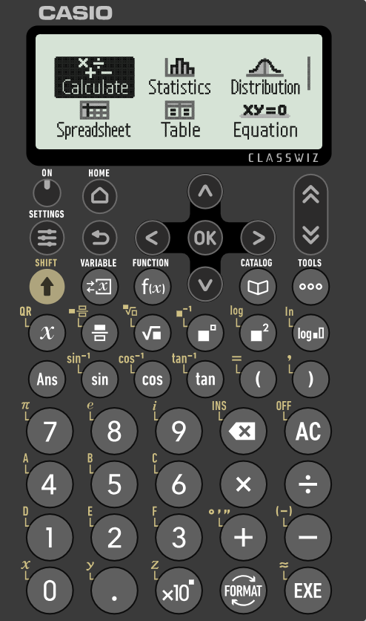
Using a calculator without a unit circle
The value of sin(θ°) or cos(θ°) can be found for any angle using one of these buttons on your calculator.
57°
m cm
123 cm
123 × cos(57°)
123 × ???

Slide 38
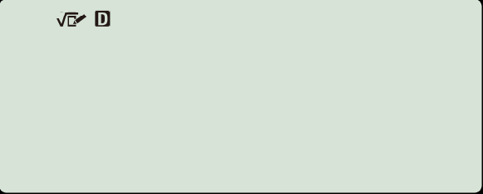
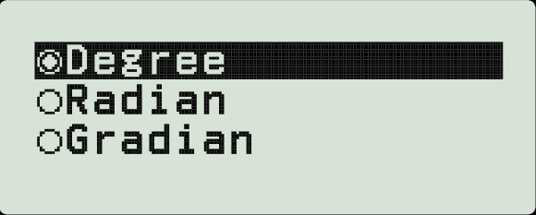
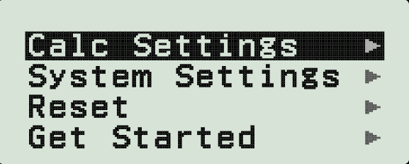
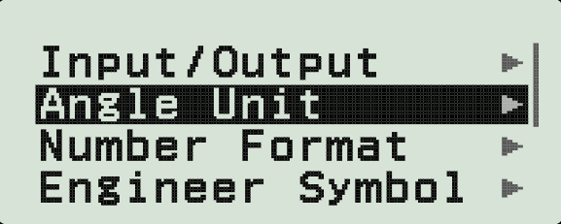

Using a calculator without a unit circle
But first, you need to check that your calculator is in the correct mode to work with angles measured in degrees.
Press the settings button and choose calc settings.
Choose angle unit and make sure that degree is chosen, not radian or gradian.
Press OK to confirm your choice.

Slide 39
Using a calculator without a unit circle
The value of sin(θ°) or cos(θ°) can be found for any angle using one of these buttons on your calculator.
Now that you know your calculator will work with angles measured in degrees, how can you use the calculator to find the length of the side adjacent to the right-angle and 57° angle?
57°
m cm
123 cm
123 × cos(57°)
123 × ???

Slide 40
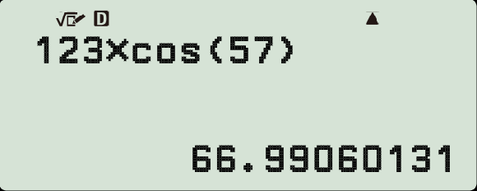

Using a calculator without a unit circle
Length of the hypotenuse
Multiplied by
m cm
57°
66.99 cm
cosine (the open bracket is automatically written)
123 cm
123 × cos(57°)
of the adjacent angle (you must write the close bracket yourself).
123 × ???

Slide 41
Using a calculator without a unit circle
Using a calculator, find the lengths of the two sides of this triangle labelled a and b (3 d.p.)
Using a calculator, find the length of the hypotenuse of this triangle (1 d.p.)
64°
7.757
cm
16 cm
b
49 cm
29°
h cm
54.5 cm
16 × cos(29°)
13.994 cm
a
opposite side = h × sin(θ°)
adjacent side = h × cos(θ°)

Slide 42
Using a calculator without a unit circle
1) Find the lengths of all sides in each of these triangles (3 d.p.)
a)
b)
c)
1 cm
1 cm
1 cm
sin(33°)
48°
33°
42°
cos(33°)
d)
e)
f)
17 cm
42 cm
42°
17°
17°
42 cm

Slide 43
Using a calculator without a unit circle
1) Find the lengths of all sides in each of these triangles (3 d.p.)
a)
b)
c)
1 cm
1 cm
1 cm
sin(33°)
48°
0.669 cm
0.669 cm
33°
0.545 cm
42°
cos(33°)
0.743 cm
0.743 cm
0.839 cm
d)
e)
12.280 cm
f)
12.841 cm
17 cm
43.919 cm
42 cm
11.375 cm
42°
17°
17°
12.633 cm
40.165 cm
42 cm

Slide 44
Sine and cosine ratios
The length of any side opposite or adjacent to an angle (θ°) in a right-angled triangle from the unit circle can be found using a table of trig values including sine and cosine.
The length of any side opposite or adjacent to an angle (θ°) in any right-angled triangle can be found by considering a similar triangle from the unit circle.
The length of the side opposite to any angle (θ°) in a right-angled triangle is equal to h × sin(θ°).
The length of the side adjacent to any angle (θ°) and the right-angle in a triangle is equal to h × cos(θ°).
The lengths sin(θ°) and cos(θ°) (for any angle θ°) can be found using a calculator.

Slide 45

© Oak National Academy 2024.
Produced in partnership with Mathematics in Education and Industry.
Licensed on the Open Government Licence v3.0, except where otherwise stated. See Oak terms and conditions.

